Slide 1
MOGA-CmpCNN: A Multi-Objective Genetic Algorithm Intergrated with CmpCNN Model for CMP-Aware Metal Fill
Presenter : Min-Feng Hsieh
Advisor : Ting-Chi Wang

Slide 2
Outline
Introduction
Preliminaries
MOGA-CmpCNN Framework
Experimental Result

Slide 3
Outline
Introduction
Preliminaries
MOGA-CmpCNN Framework
Experimental Result

Slide 4
Introduction
Chemical Mechanical Polishing (CMP) 化學機械拋光
Achieving uniform planarization in the fabrication of integrated circuits (ICs).
Using metal fill can maintain the uniform metal density, which is important for CMP.
Metal fill generally contain 2 phases:
Fill synthesis.
Determine the amount to be inserted.
Fill insertion.
Place the fill in the layout.
Notes:
*实现均匀平坦化

Slide 5
Introduction
Rule-based metal fill algorithms
The Density related rules can result in larger post-CMP height variations.
Model-based algorithms
Accounting only for density/perimeter factors requires improvements for better predictive accuracy.
Embracing machine learning (ML) techniques
NeurFill: with a CMP neural network as the CMP simulator for fill synthesis.
Handling fill synthesis and fill insertion as separate processes can result in a lack of holistic perspective during the synthesis stage.
Notes:
2.这些经验模型仅考虑密度/周长因素，需要改进以提高预测精度
*实现均匀平坦化
*将填充合成和填充插入作为独立的过程可能导致在合成阶段缺乏整体视角

Slide 6
Outline
Introduction
Preliminaries
MOGA-CmpCNN Framework
Experimental Result

Slide 7
Preliminaries – Fill Patterns
Fill pattern in the metal fill process is important for the layout uniformity and reliability.
Rectangular metal fill
Most commonly used, which evenly distributes metal density
With different distribution characteristic functions (DCF), the fill width and the fill height are variables to lower the capacitance.
Staggered (交錯), alternate (交替), and basket-weave (編織式)
Enhance manufacturability.
Staggered is preferred with the ability to result in a more uniform etching rate.

Slide 8
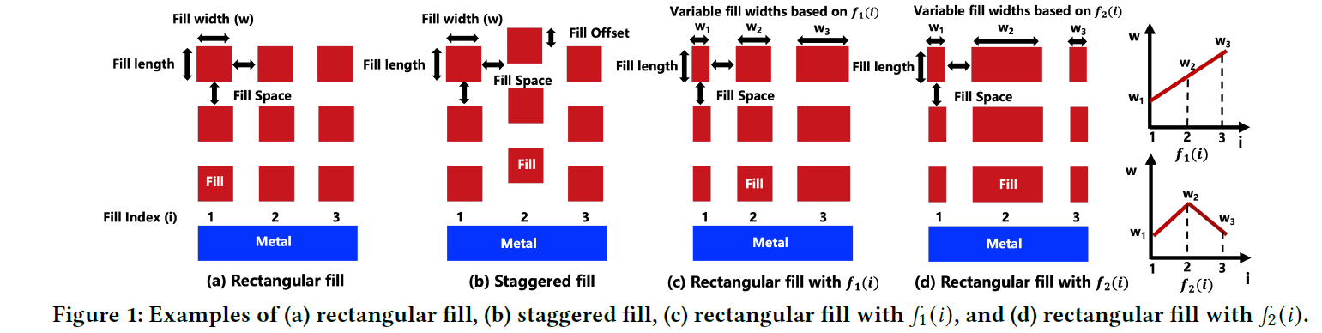
Preliminaries – Fill Patterns

Slide 9
Preliminaries – CmpCNN Model
Accurate CMP model for height prediction to guide the fill process is of great importance.
Achieve 1.89× error reduction while also maintaining 57× speedup.

Slide 10
Outline
Introduction
Preliminaries
MOGA-CmpCNN Framework
Experimental Result

Slide 11
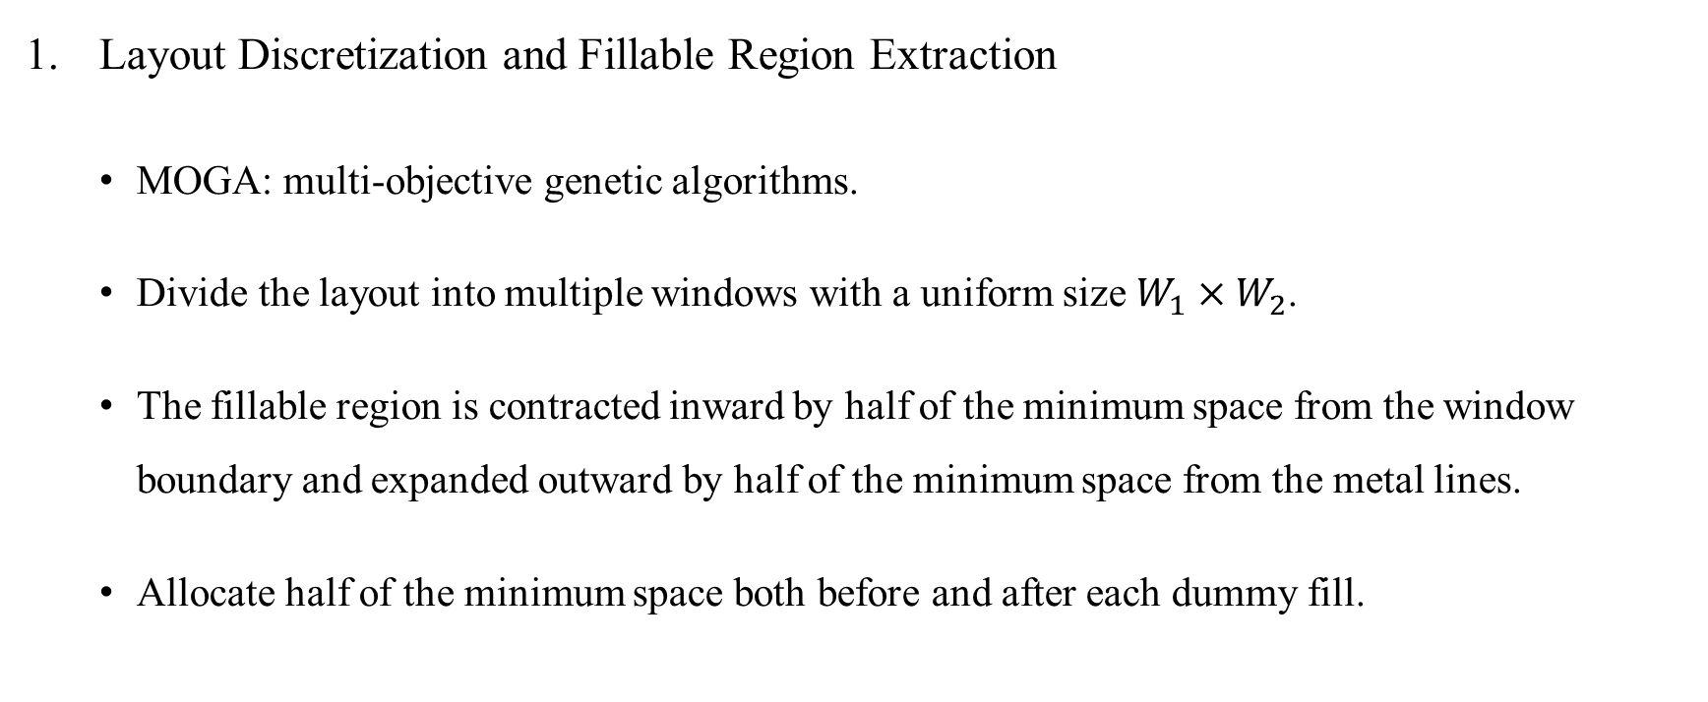
MOGA-CmpCNN Framework
Layout Discretization and Fillable Region Extraction
MOGA: multi-objective genetic algorithms.
Divide the layout into multiple windows with a uniform size $W_{1}×W_{2}$.
The fillable region is contracted inward by half of the minimum space from the window boundary and expanded outward by half of the minimum space from the metal lines.
Allocate half of the minimum space both before and after each dummy fill.
Notes:
* Subsequent 接下來的
* 這樣就有符合minimum spacing的要求了 (To ensure DRC-complaint)

Slide 12
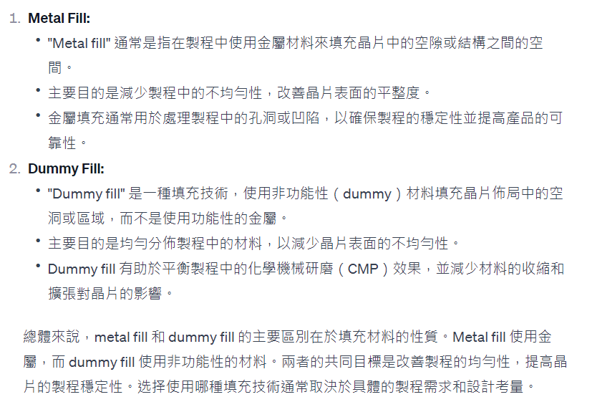

Slide 13
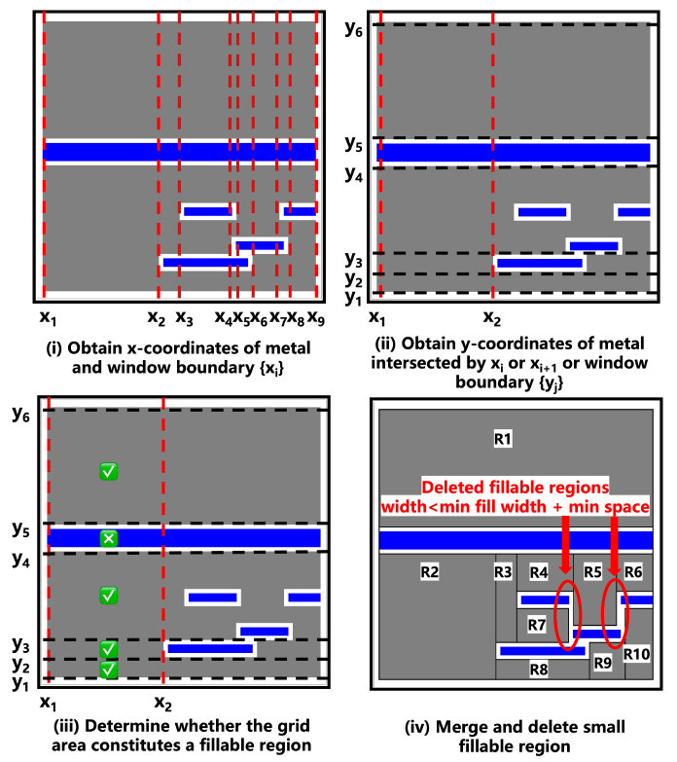
Notes:
找出所有metal跟windows的boundary {xi}
依序(x1,x2), (x2,x3)…
找出與這個邊界有交集的metal的y (metal邊界以及window的邊界)
決定他是不是fillable region (應該就是沒有metal)
若fillable region的寬度小於min_fill_width + min_space的話，就把她刪除
若高度(y方向)相同，可以合併

Slide 14
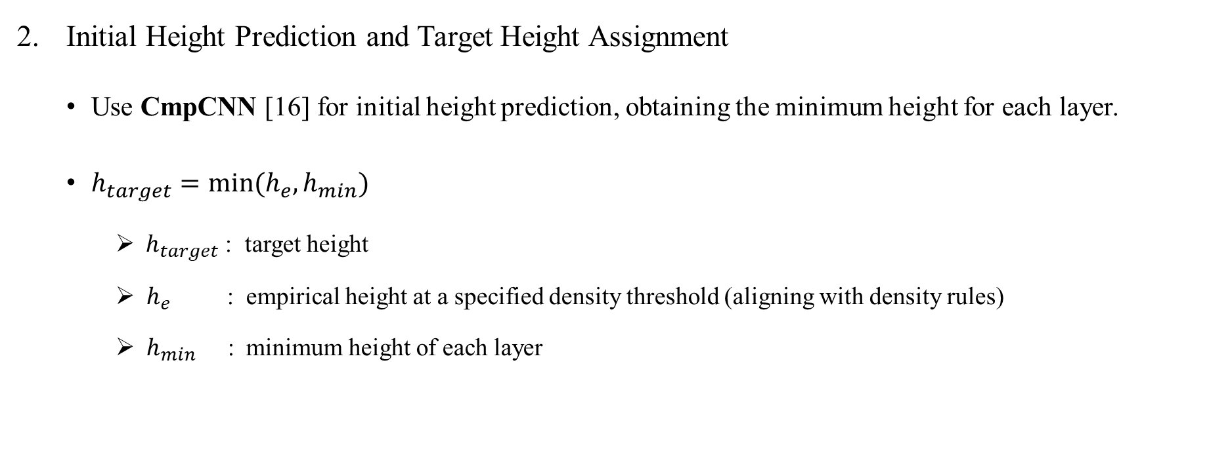
MOGA-CmpCNN Framework
Initial Height Prediction and Target Height Assignment
Use CmpCNN [16] for initial height prediction, obtaining the minimum height for each layer.
$h_{target}=min⁡(h_{e}, h_{min})$
$h_{target}$ : target height
$h_{e}$ : empirical height at a specified density threshold (aligning with density rules)
$h_{min}$ : minimum height of each layer
Notes:
* initial height prediction是得到minimum height
* he 是指在符合density rule的情況下，可以得到的高度。

Slide 15
MOGA-CmpCNN Framework
MOGA-CmpCNN Fill Insertion
View the entire metal fill process as a unified entity.
Integrate MOGA with CmpCNN model to optimize fill width, fill length, and fill space in 2 directions.

Slide 16
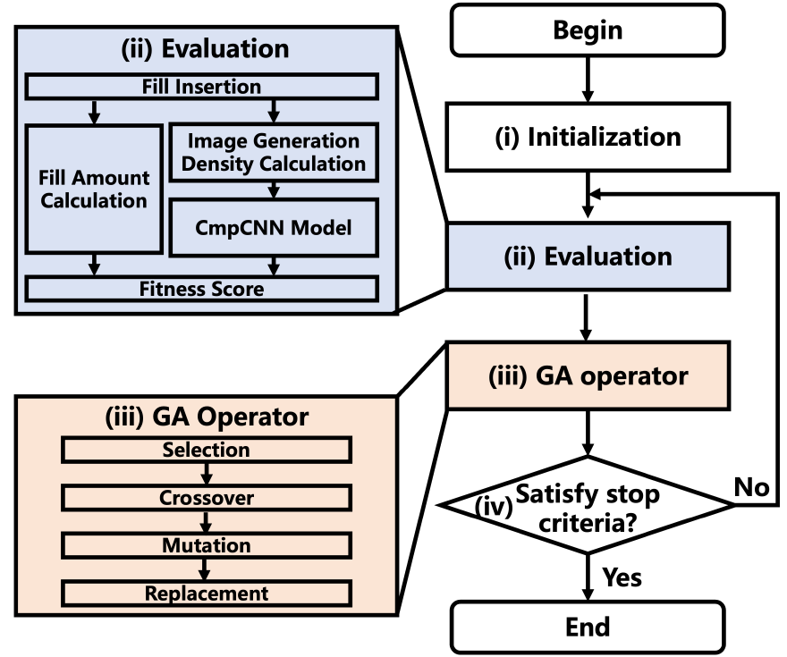
MOGA-CmpCNN Framework
MOGA-CmpCNN Fill Insertion
Initialization
Generate an initial population of individuals,
each characterized by values for fill parameters.

Slide 17
MOGA-CmpCNN Framework
MOGA-CmpCNN Fill Insertion
(ii) Evaluation
Generate precise fill solutions based on
individual fill parameters and evaluate the
corresponding fitness score.
Notes:
一開始會有初始解，即fill insertion solution，之後會把它丟進CMPCNN，並且算出適應度的分數

Slide 18
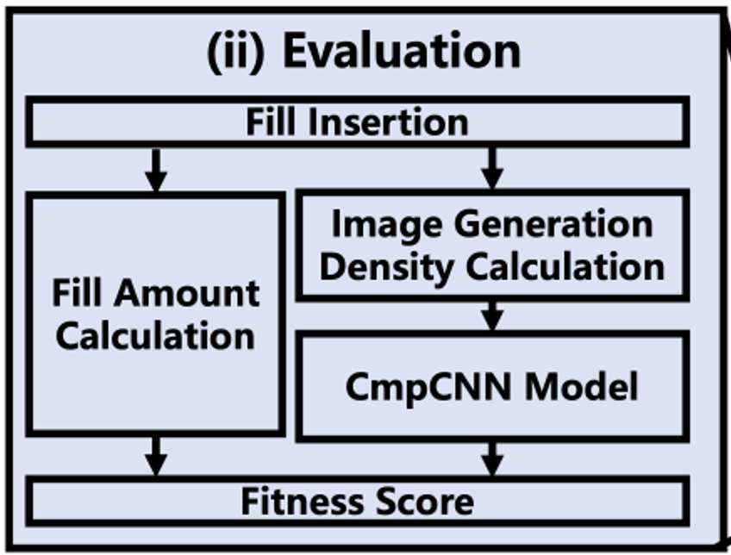
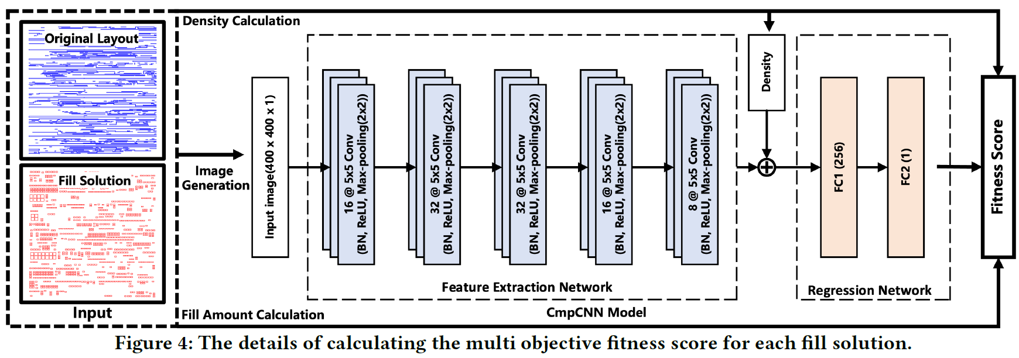
MOGA-CmpCNN Framework [16]
Notes:
在生成fill solution後，會進行圖像生成以及密度的計算。圖像會先進行feature extraction，並且將這些特徵與density一起丟到regression network來進行填充高度的預測。 之後會用剛剛的fitness score來計算適應度分數。

Slide 19
MOGA-CmpCNN Framework
MOGA-CmpCNN Fill Insertion
(iii) GA Operator
Create a new generation of individuals by
applying GA operators simultaneously,
including selection, crossover, mutation, and
replacement.
Notes:
進行pertubation(選擇 交配 突變 取代等等)

Slide 20
MOGA-CmpCNN Framework
MOGA-CmpCNN Fill Insertion
(iv) Stop or iteration
If stop conditions are satisfied (e.g., number of
generations, achieving satisfactory fitness
score, or convergence), the algorithm
stops, returning the best fill solution. Otherwise,
return to step (ii) and repeat the optimization
process.

Slide 21
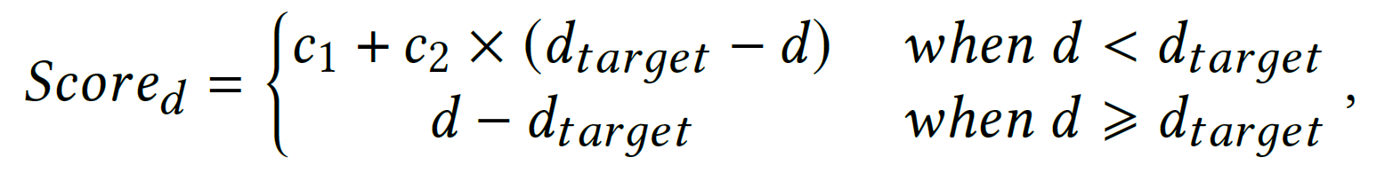
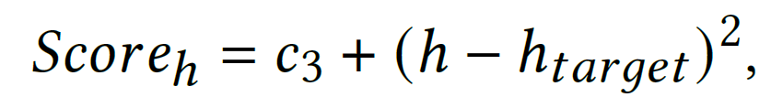
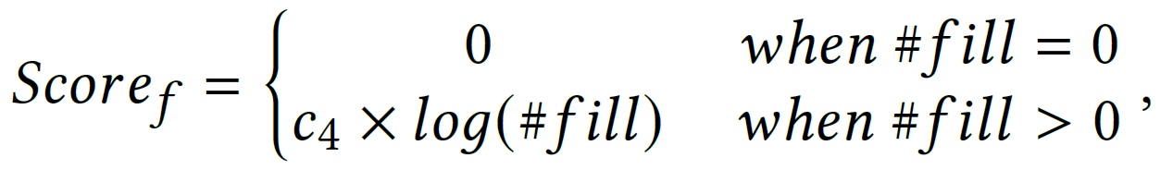


MOGA-CmpCNN Framework
MOGA-CmpCNN Fill Insertion
Multi-Objective Fitness Score
$Fitness score$= density score (${Score}_{d}$) + height score (${Score}_{h}$) + fill amount score (${Score}_{f}$).
$d: density of the fill solution$
$d_{target}: target density$
$h: predicted height of the fill solution$
$h_{target}: target height$
$\#fill: fill amount$
Notes:
* Dtarget沒寫是甚麼
越小越好
降低post-CMP height variations
降低fill amount

Slide 22
Outline
Introduction
Preliminaries
MOGA-CmpCNN Framework
Experimental Result

Slide 23
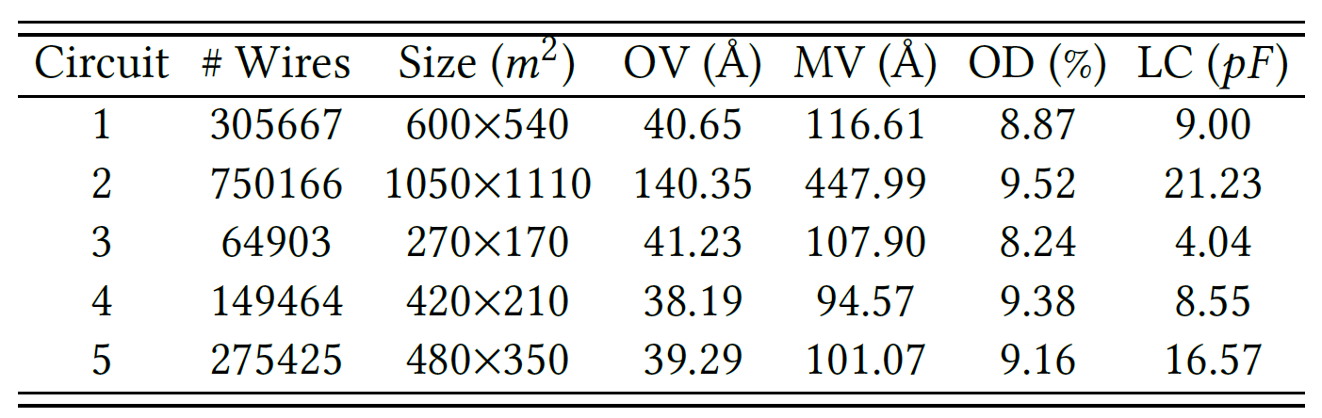
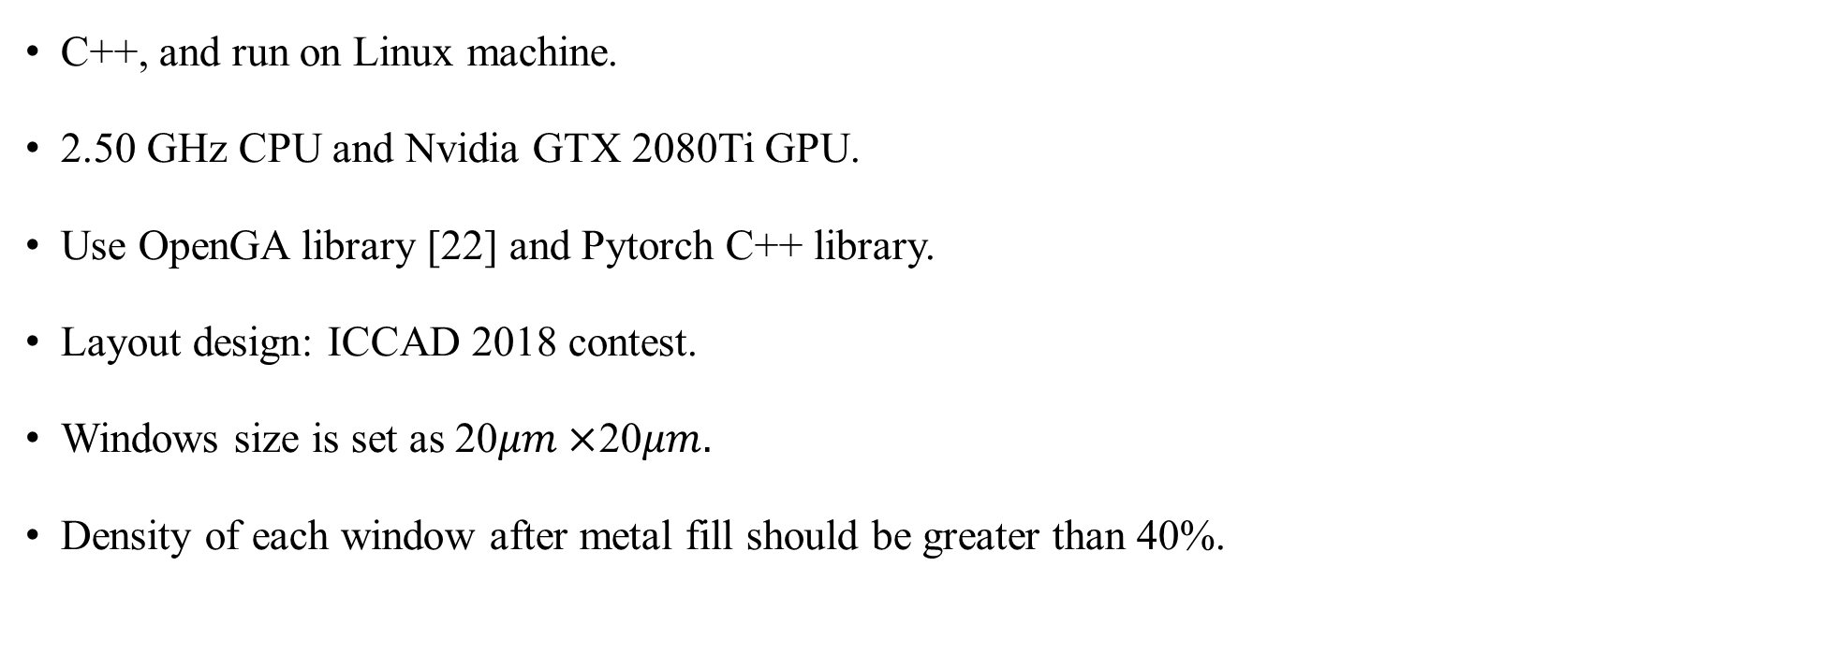
Experimental Result
C++, and run on Linux machine.
2.50 GHz CPU and Nvidia GTX 2080Ti GPU.
Use OpenGA library [22] and Pytorch C++ library.
Layout design: ICCAD 2018 contest.
Windows size is set as 20$μm×$20$μm.$
Density of each window after metal fill should be greater than 40%.
Notes:
openGA: genetic algorithm

Slide 24
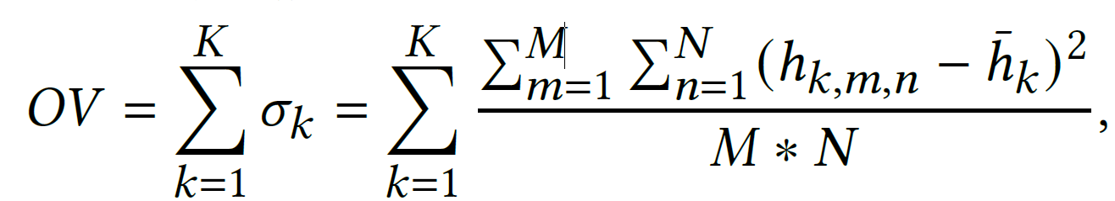

Experimental Result
Overall Variation (OV)
Sum of standard deviations of height per layer $σ_{k}$.
K: total layer.
M (N): column (row) of layout windows.
$h_{k,m,n}$: windows height.
$\overline{h_{k} }:$ average height of the corresponding layer.
Notes:
每一層的高度都有一個對應的高度標準差（描述該層內高度的變異情況）。OV則是這些標準差的總和。這裡的每一層用 𝜎𝑘 來表示，其中 𝜎 是標準差的符號，而 𝑘 是層的索引。

Slide 25

Experimental Result
Max Variation (MV)
Computes the maximum deviation of accumulated height across layers.
$MV=\max\left(H_{m,n}\right) −min(H_{m,n})$
𝐻(𝑚,𝑛) = $\sum_{k=1}^{K}{h_{k,m,n}}$ , where denotes the cumulative height of each window.
Notes:
將同一個window的每一層高度加起來，並且用最大值減最小值

Slide 26
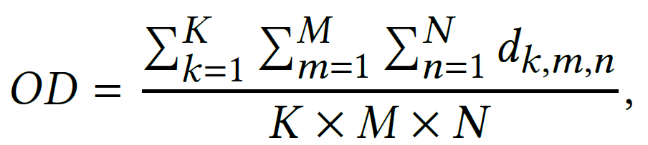

Experimental Result
Overall Density (OD)
Computes the overall density of the entire layout across layers.
$d_{k,m,n}$denotes the metal density of each windows.
Notes:
整個layout的平均density (包含所有層)

Slide 27

Experimental Result
Lateral Capacitance (LC)
Computes the capacitance formed by the conductors on the same layer.
$LC= P_{l}\left(d\right) ×l$
$l:$length of parallel edges of conductors.
$d:$the distance between parallel edges.
$P_{l}:$lateral capacitance per unit length.
Notes:
* 横向电容
* 同一层上导体形成的电容，通过将平行边缘之间的距离乘以单位长度的横向电容。

Slide 28
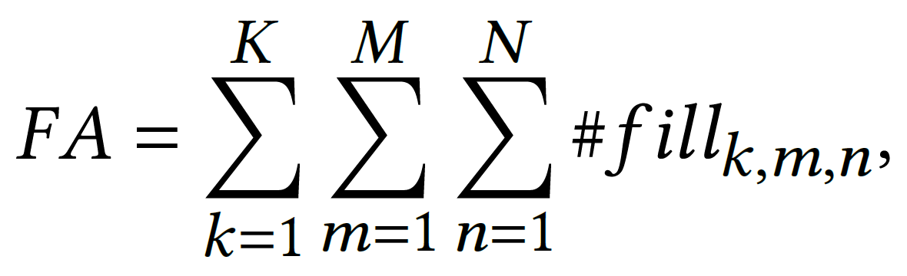

Experimental Result
Fill Amount (FA)
Computes the total fill amount of each window across layers.
$\#{fill}_{k,m,n} :$denotes the fill amount of each window.
Notes:
每個windows的填充量的加總

Slide 29

Experimental Result
Goal
Given a layout with a uniformed window size $W_{1} ×W_{2}$.
To insert fills with minimum overall variation, max variation, overall density, fill amount, and lateral capacitance while meeting the design rule constrains (DRC).

Slide 30
Experimental Result
Performance of CmpCNN Model
Employ commercial metal fill tool (Smartfill), to generate fill solutions with different fill parameters.
Perform clip generation to partition layout with/without fill solutions into multiple clips (20×20μm).
Perform CMP simulation and image binarization to generate data samples (>10000) to train a model.
The normalized root mean square error of our model is 5% (<10%).
Notes:
* 這邊是在說要怎麼train model
* fill parameters: fill width and fill length

Slide 31
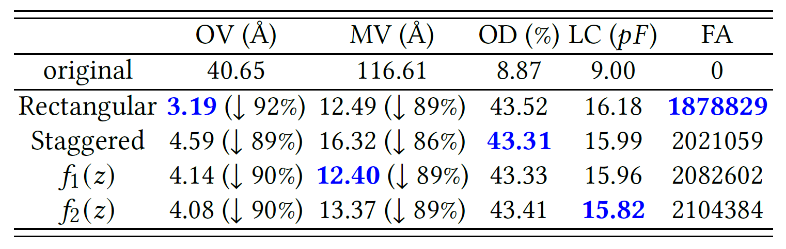
Experimental Result
Investigation of Different Fill Patterns
Notes:
最佳填充模式应根据高度变化、电容等因素的具体需求和权衡来确定。
接下来的实验中将使用矩形填充，主要目标是最小化高度变化。

Slide 33
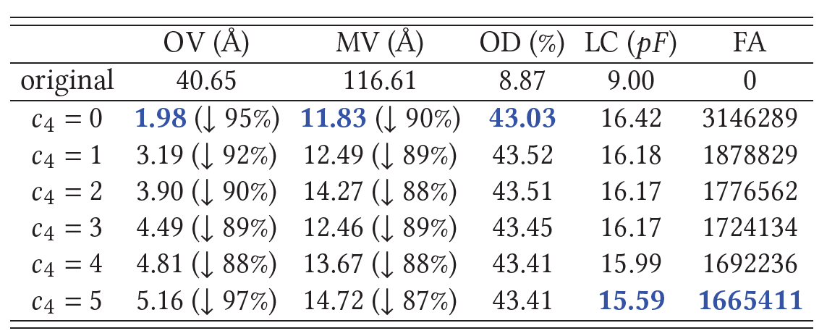

Experimental Result
Effectiveness of Multi-objective Fitness Score
$c_{1}=c_{2}= c_{3}=100$, $c_{4}=1$
Notes:
* 小的填充量得分对减少FA的影响较小，而大的填充量得分会导致更大的高度变化
* 𝑐4被设置为1，因为它在只有轻微增加OV和MV的情况下实现了FA的显著减少。

Slide 34
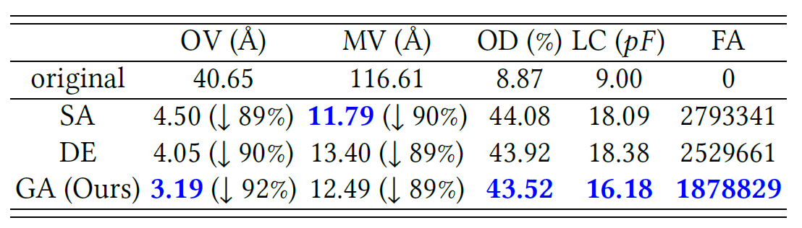
Experimental Result
Effectiveness of Genetic Algorithm
DE: differential evolution

Slide 35
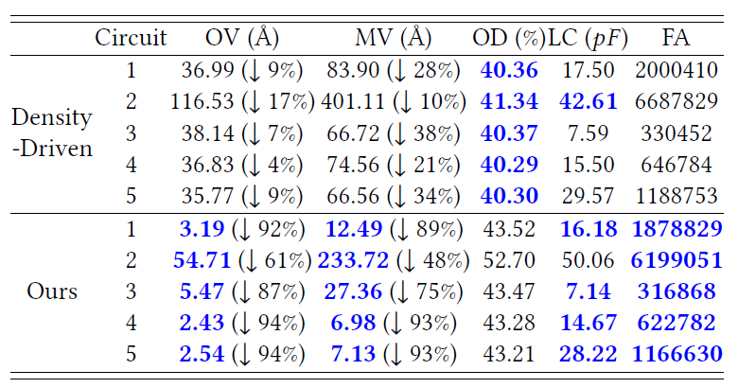
Experimental Result
Performance Comparison
Notes:
* Density driven: 會有比較大的OV (跟現在的MULTI-OBJECTIVE相比)
* "Circuit2表現出較大的LC和OD，主要是由於原始佈局中存在顯著的高度變化（MV = 447.99 Å），需要更廣泛的填充區域來確保佈局平整。圖5顯示了電路1和電路2的高度分佈，包括原始電路、密度驅動填充的電路，以及我們的MOGA-CmpCNN填充的電路。總的來說，我們的MOGA-CmpCNN框架在最小化OV和MV方面表現出色，並且具有更小的FA和LC。"

Slide 36
Thank you for listening!

